Slide 1
Welcome To York Code Dojo
David Betteridge
Yorkdevelopers.org
@yorkdevelopers
@yorkcodedojo

Slide 2
Agenda
Quick Introduction
Explain the problem
Work in pairs till 8.45pm
Opportunity to show off solutions
Pub about 9pm

Slide 3

Code Dojo
Notes:
Who has been to a code dojo before?
What is the point?
It’s a place to practice coding safely. By that we mean it doesn’t matter if you haven’t solved the problem by the end of the evening. No one will judge you on it. It’s a place to practice, learn and try out new things.
For example you could use a language you have never used before, partner with someone new, try a different approach to solving the problem. You could add your own constraints; like my functions won’t have more than three lines; or I’m not going to use any IF statements.
(It’s also meant to be fun) It’s driving a car to work every day, you might cover a lot of miles, but if you are doing the same journey then does your driving ability really improve?
It’s driving a car to work every day, you might cover a lot of miles, but if you are doing the same journey then does your driving ability really improve?

Slide 4
Tonight – Test Driven Development (TDD)
Test-driven development (TDD) is a software development process that relies on the repetition of a very short development cycle: first the developer writes an (initially failing) automated test case that defines a desired improvement or new function, then produces the minimum amount of code to pass that test, and finally refactors the new code to acceptable standards.
Notes:
Who has done TDD before?
Who knows what it is?

Slide 5
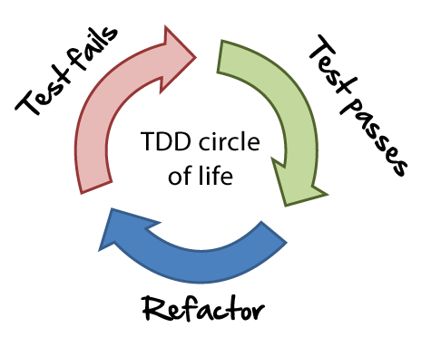
Tonight – Test Driven Development (TDD)
Notes:
Three stages
Write a failing test
Write the smallest amount of code to make that test pass
Refactor your code
Next test
Do a demo if needed

Slide 6
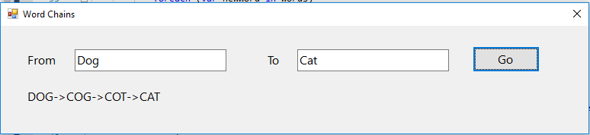
Word Chains
Notes:
Write a program that has to convert one word into another word
Ruby -> Code
Lead -> Gold
You can only change one letter at a time
There is a file of words available if you need it on the git hub site
What would be a good initial test?
And then what?
Can your program produce the shortest possible chain?
Don’t worry if your don’t get finished tonight – quality is more important!

Slide 7
York Developers
Games Developers (Last Thursday of the month)
Code and Coffee (Monday and Wednesday mornings)
Agile York (3rd Wednesday of the month)
Dot Net York

